Slide 1



How to Back up (save) and load
SD card

Slide 2

Back up SD CARD
in your laptop

Slide 3
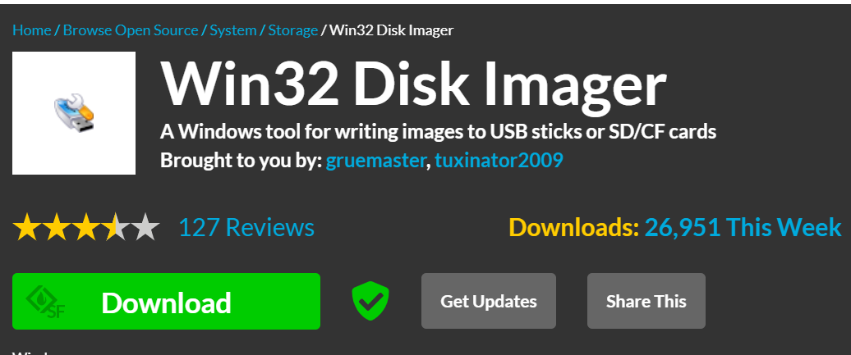
Download and install win32 Disk Imager
https://sourceforge.net/projects/win32diskimager/

Slide 4
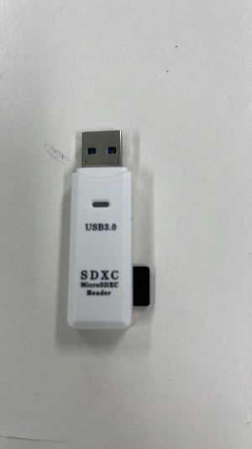
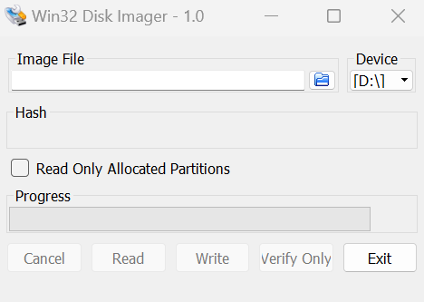
Take out the SD card, insert it into a SD card reader and connect to the USB port of your laptop.
Open win32 Disk Imager.
Select Device either D:\ or E:\ or F:\ but it must not be your laptop’s driver (C:\).
Click the blue icon folder.
**You cannot open Win32 Disk Imager if you have installed google drive on your laptop. If have, disable google drive.
**If cannot, run as administrator as well

Slide 5
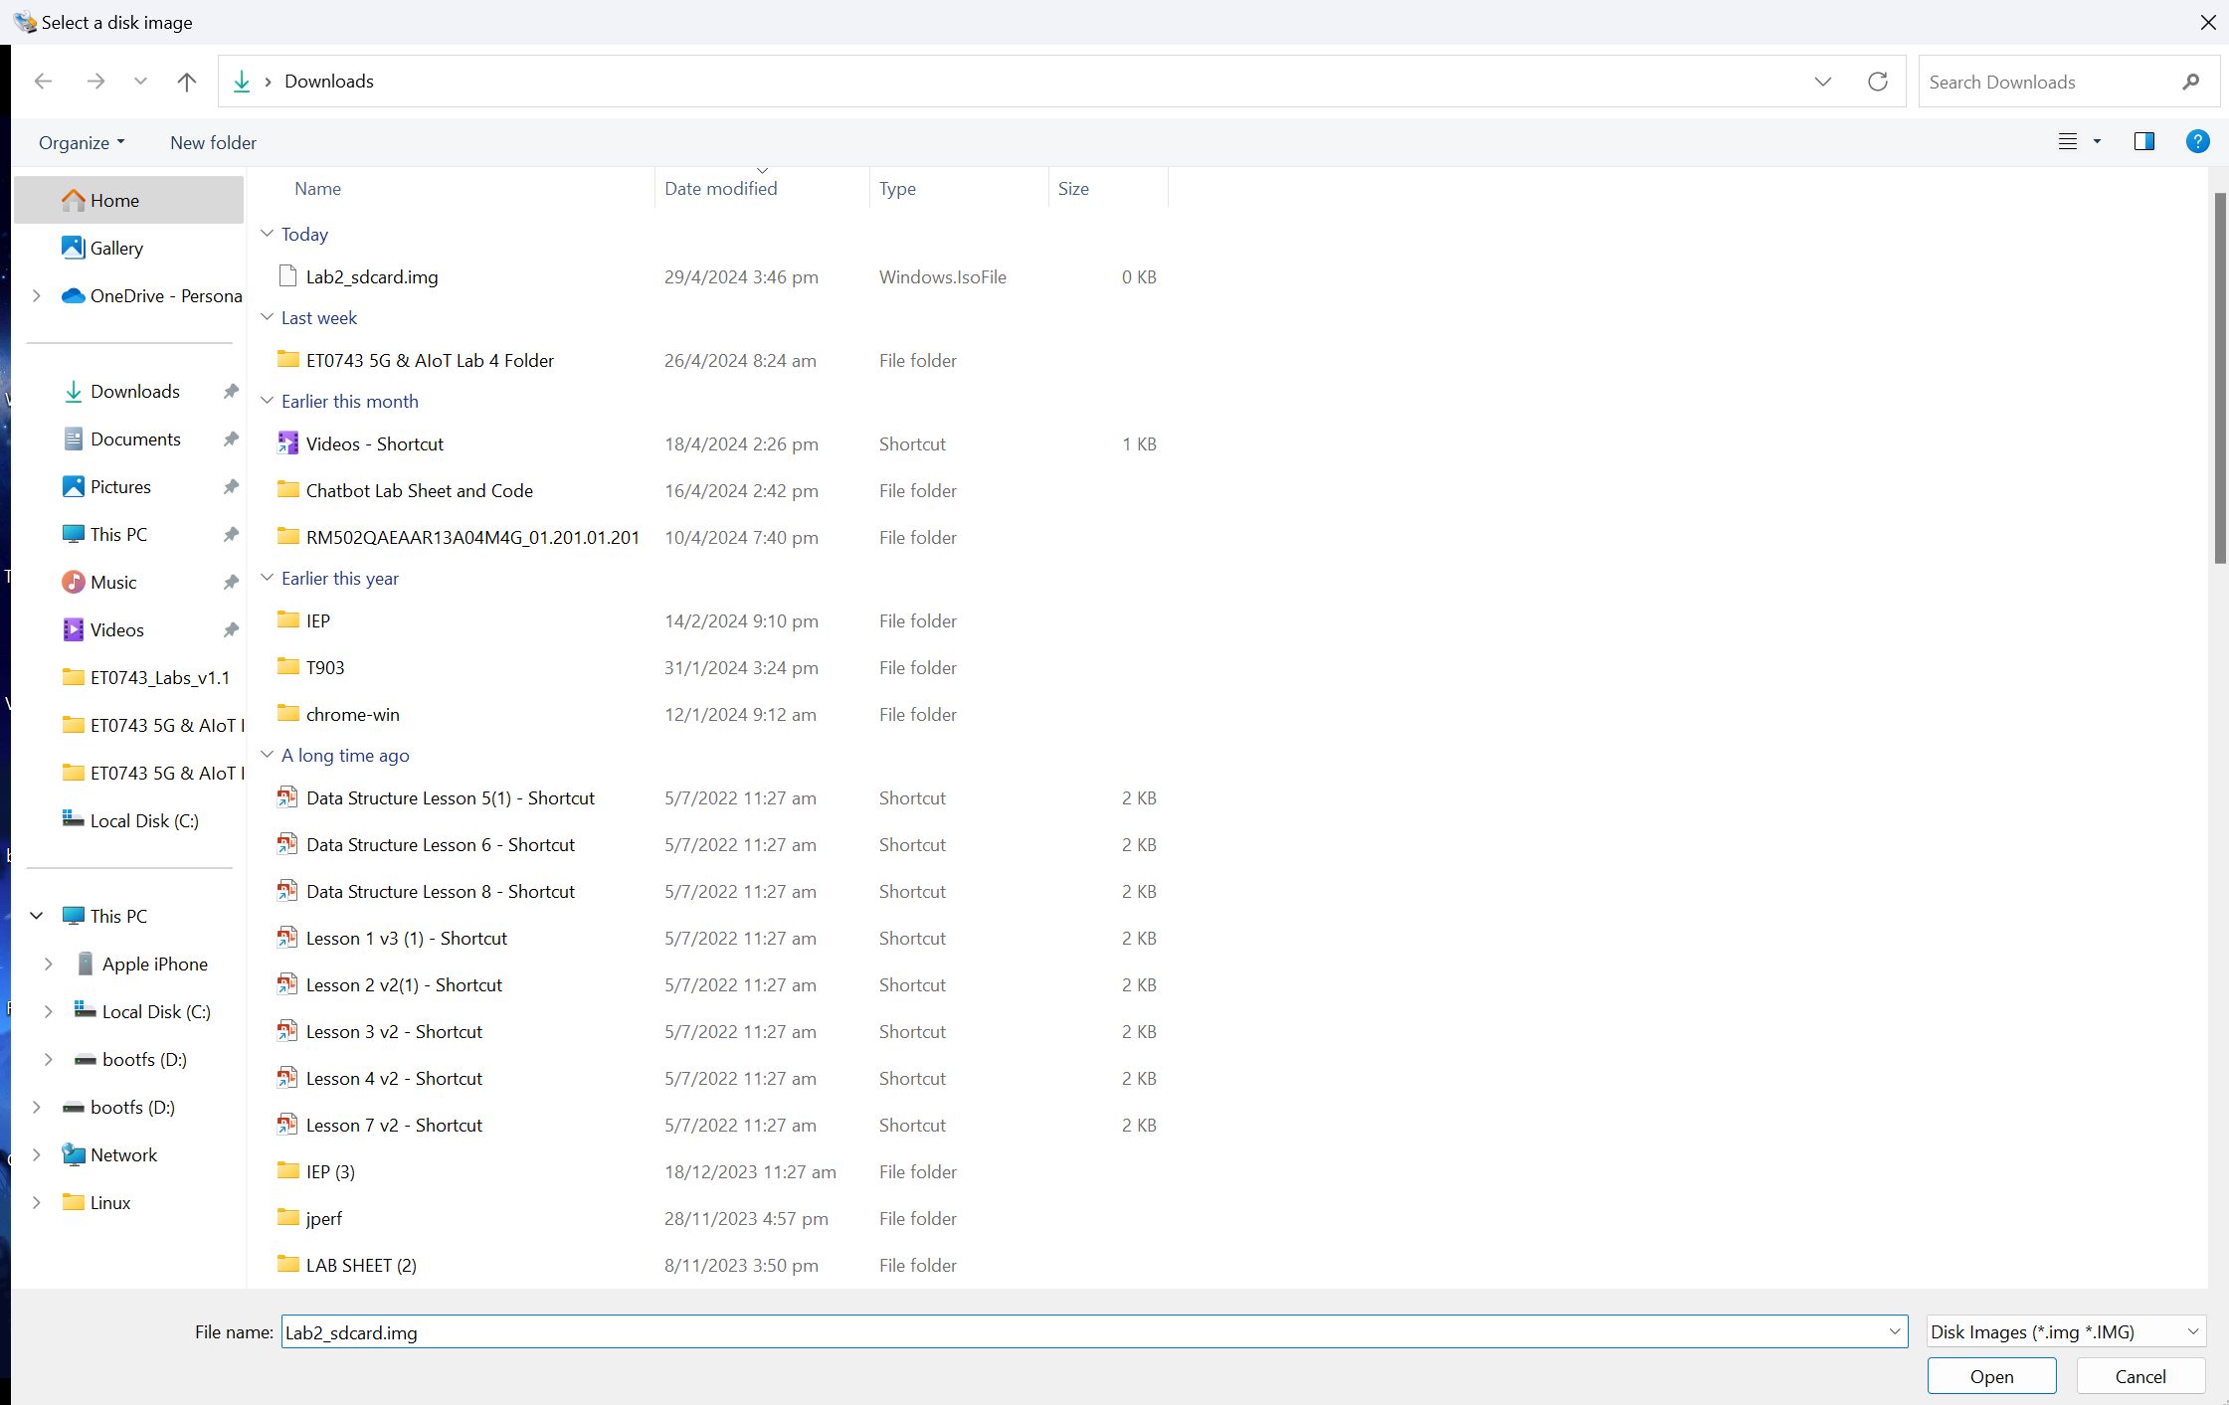
Choose a folder (C:\) and type in the file name as:
ET0743_Miniproject_sdcard.img
Then click open.
**YOU MUST ENSURE THAT THE FILE HAS THE EXTENSION (.img)
Ignore the file name above

Slide 6
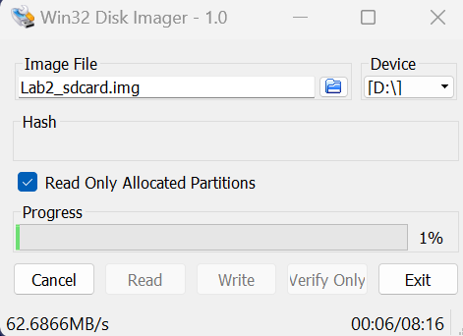
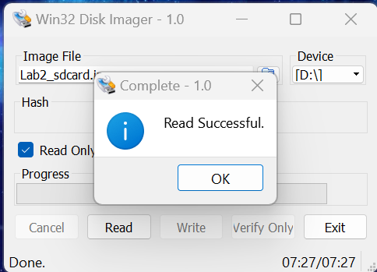
Before you read, ensure that local disk (C:) has at least 32GB of available space.
Tick the “Read only allocated partitions” and select “Read”.
When the read is successful, you should be able to see ET0743_Miniproject_sdcard.img file with a size of 32 GB.

Slide 7
LOAD SD CARD
FROM your laptop

Slide 8
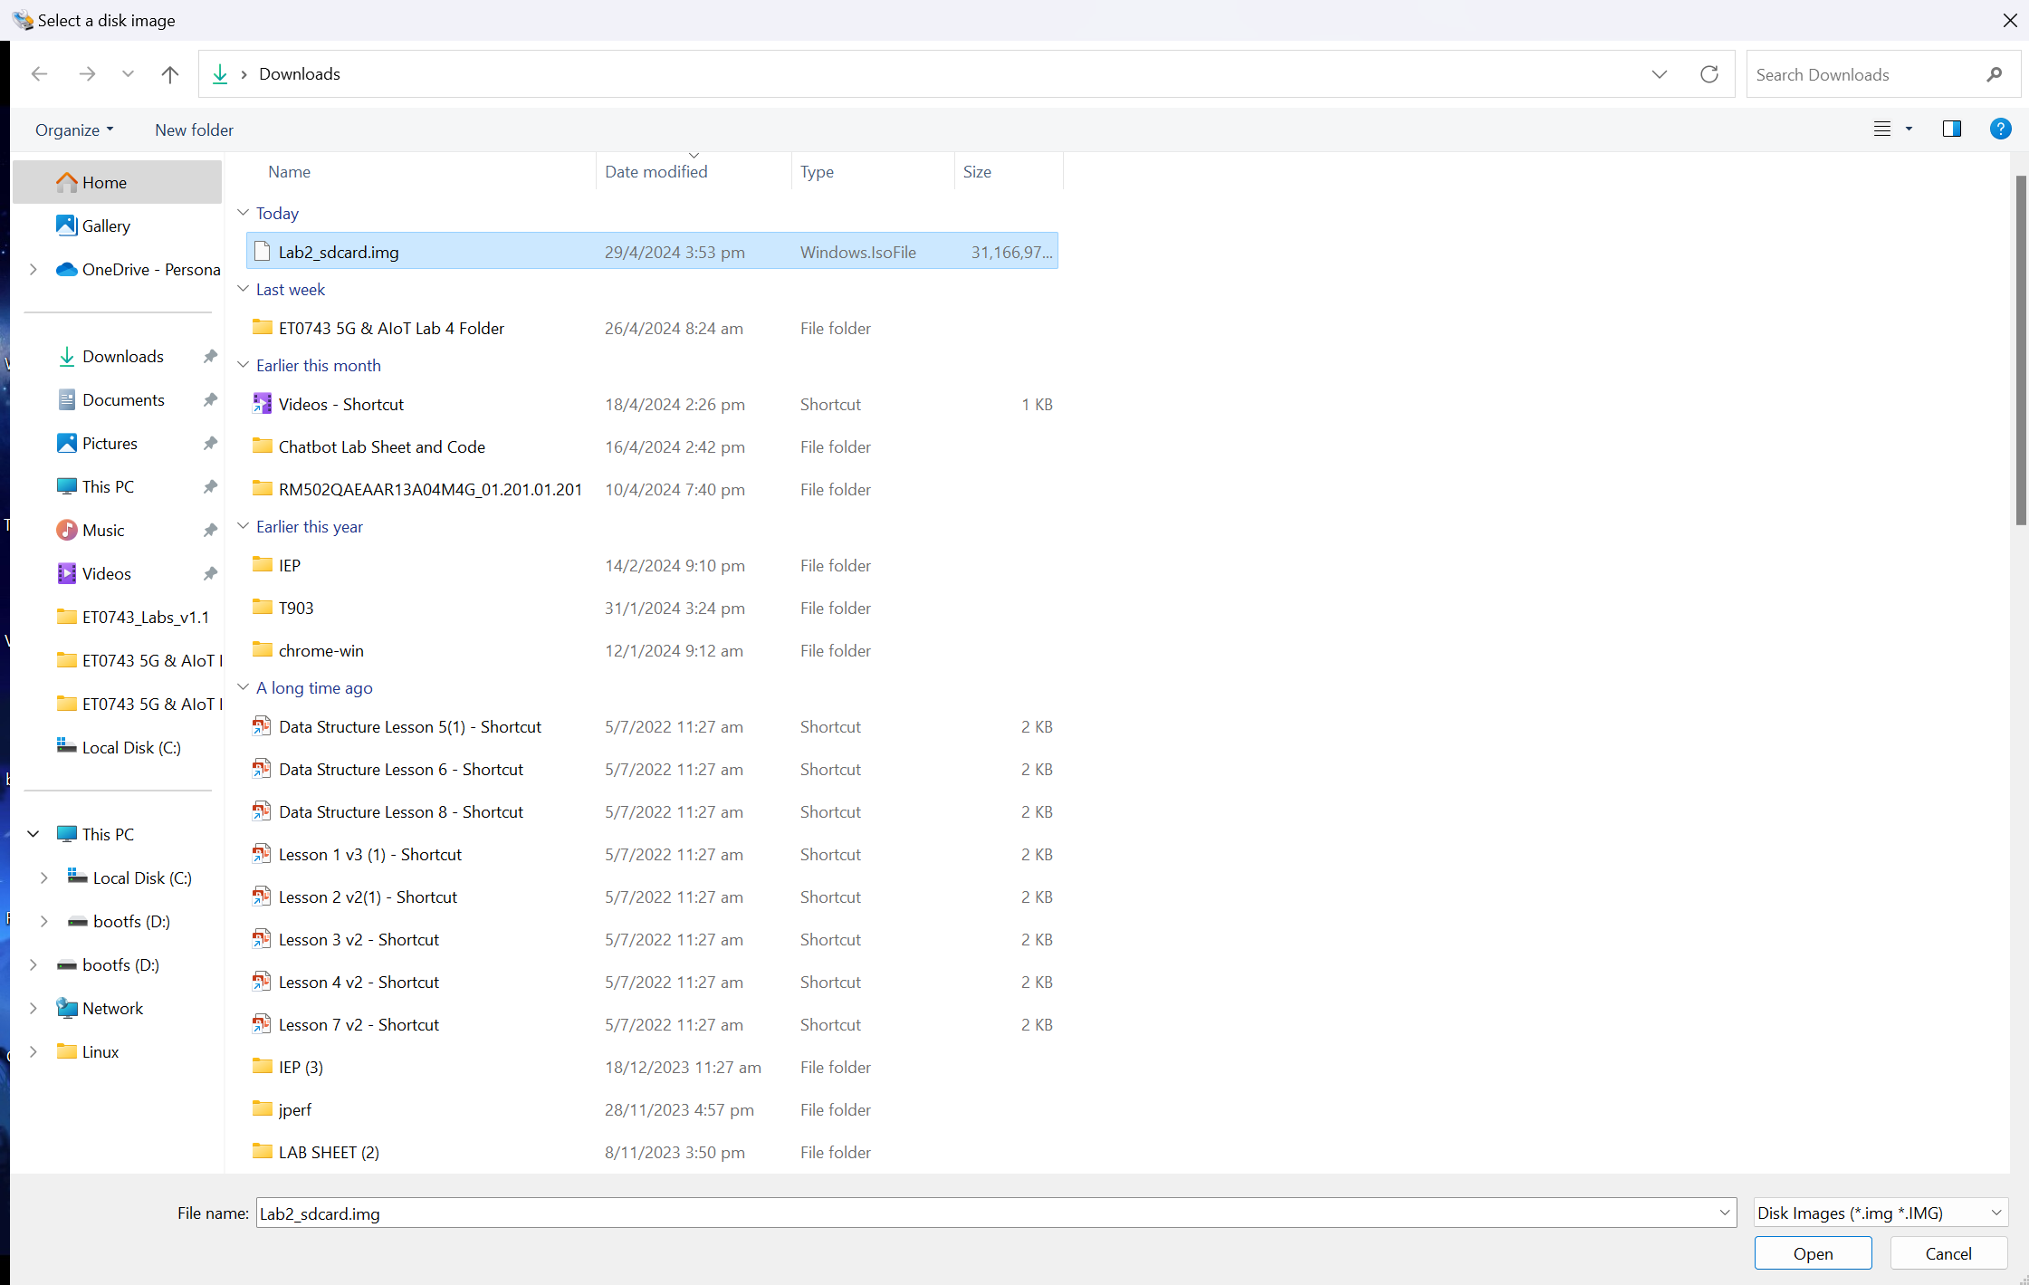
Now, we are going to load the back up image file into a new or same SD card.
Insert the SD card reader and open Win32 Disk Imager.
Click on the blue folder icon and open ET0743_Miniproject_sdcard.img file.
**If you cannot find the file, it is either in another folder or you did not save the back up SD card with the extensions (.img)
Ignore the file name above

Slide 9
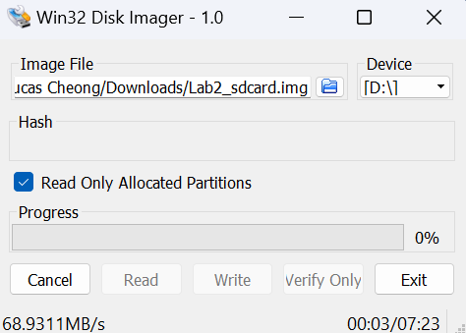
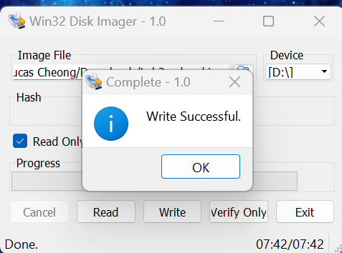
Select Device and “Write”

